Slide 2
What does Darth Vader do every morning?

Slide 3
6:15
He gets up at quarter past six.

Slide 4
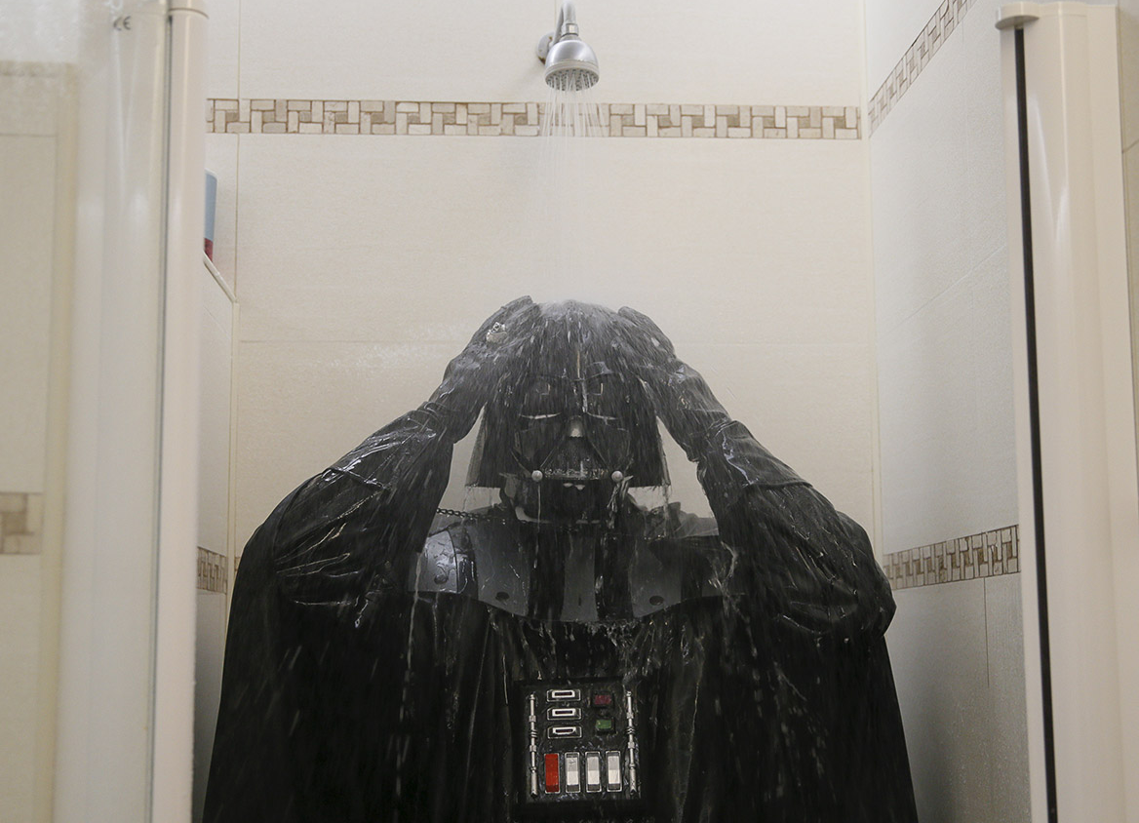
6:30
He has a shower at half past six.

Slide 5
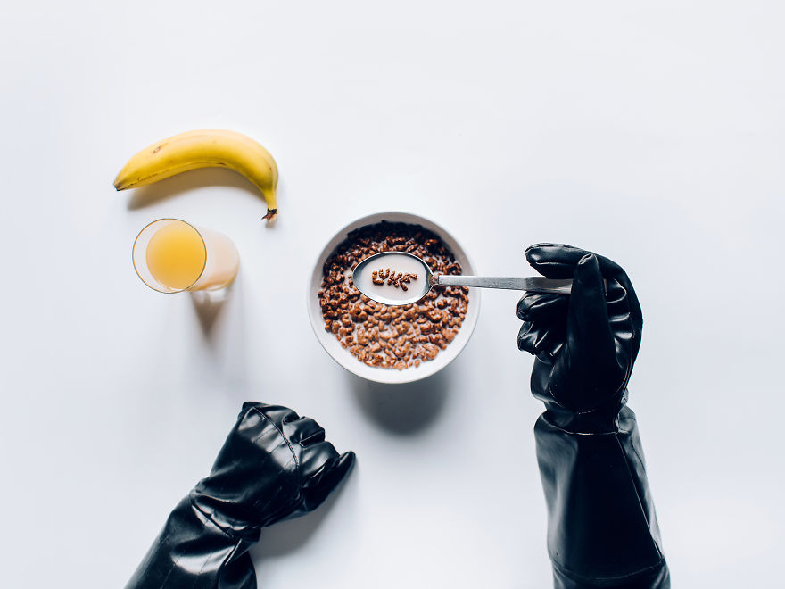
6:45
He has breakfast at quarter to seven.

Slide 6
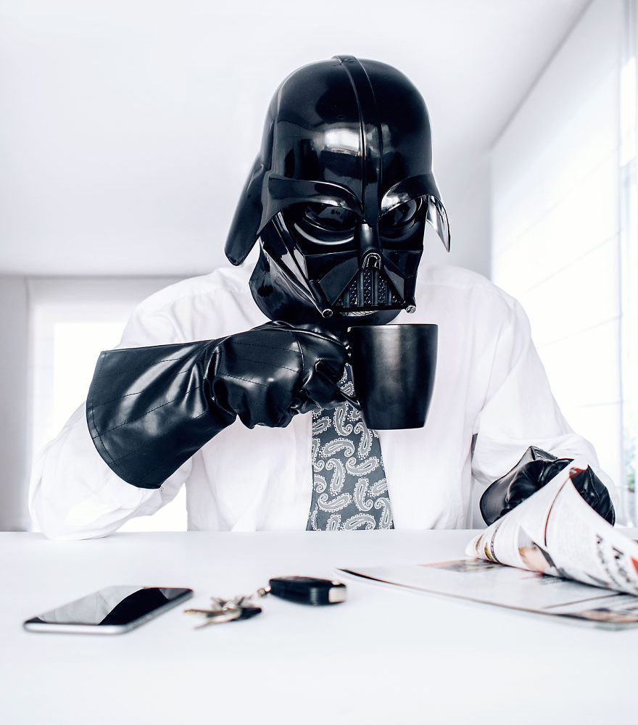
6:55
He drinks his coffee at five to seven.

Slide 7
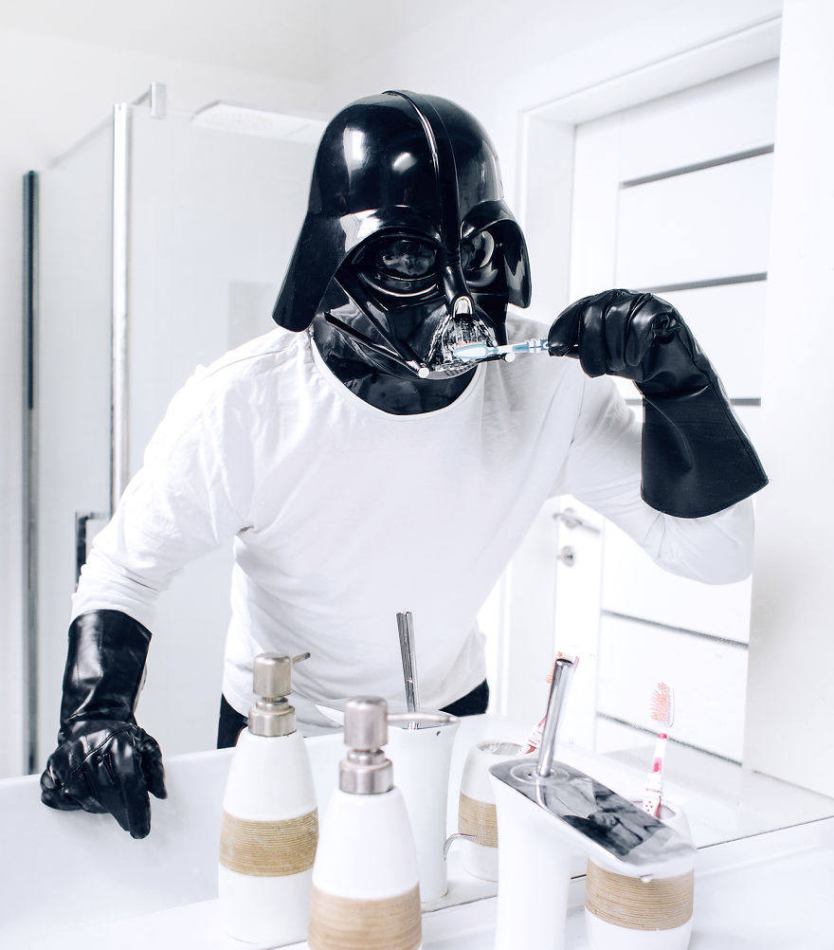
7:00
He brushes his teeth at seven o’clock.

Slide 8
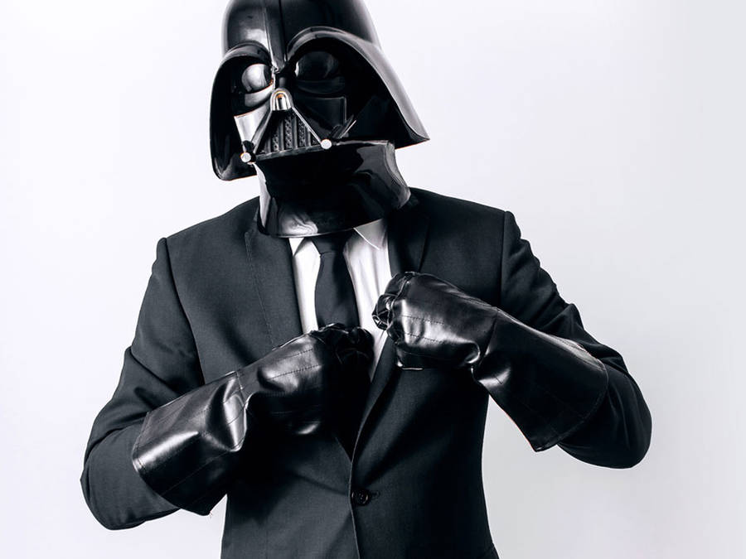
7:05
He gets dressed at five past seven.

Slide 9
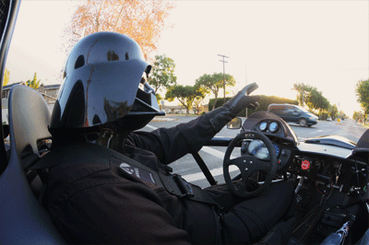
7:15
He goes to work at quarter past seven.

Slide 10
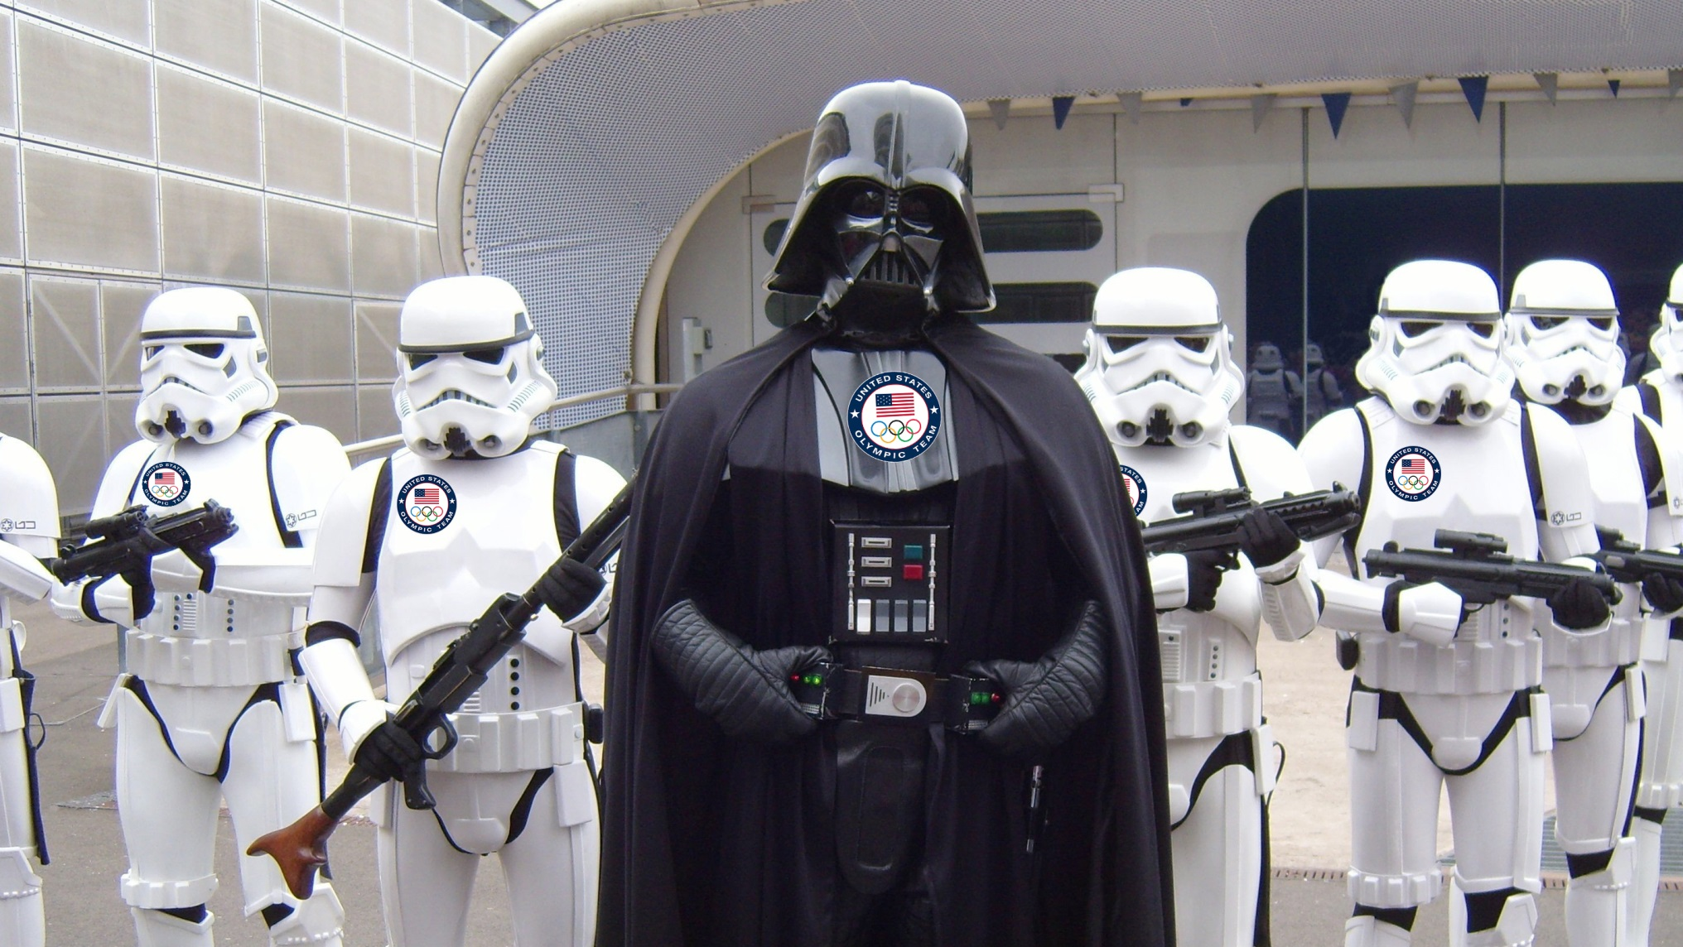
8:00
He starts work at eight o’clock.

Slide 11
And what does a stormtrooper do every day?
Let’s find out!
https://www.youtube.com/watch?v=Kz3FeSDWxvI&t=103s

